Slide 1



PsychoPy
Local set up
Experiment creation
PsychoJS

Slide 2
Time | Day 1 | Day 2 | Day 3
9:00 - 10:00 | Virtual arrivals / Coffee/Equipment check | Introducing Pavlovia | Introduction to python concepts.
10:00 - 11:00 | Creating experiments in PsychoPy Builder | Running experiments online with Pavlovia.org | Coding an experiment from scratch using python.
11:00 - 12:00 |  | Special considerations for online studies
12:00 – 13:00 | LUNCH | LUNCH | LUNCH
13:00 – 14:00 | Extending experiments with python code. | Debugging 101: Common errors and how to fix them | Integrating external hardware (fMRI, EEG, eye tracking)
14:00 – 15:00 | Clocks and Trial counters
15:00 – 16:00 |  | Make your own experiment.
16:00 – 17:00 | Make your own experiment.* | Make your own experiment.* | Goodbyes
* This is time for you to use the skills you have learned in the day to make your own experiment, with the PsychoPy team available for (virtual) “hands on” guidance.

Slide 3
Day 1 | Day 2 | Day 3
Virtual arrivals / Coffee/Equipment check | Introducing Pavlovia | Introduction to python concepts.
Creating experiments in PsychoPy Builder | Running experiments online with Pavlovia.org | Coding an experiment from scratch using python.
LUNCH | LUNCH | LUNCH
Extending experiments with python code. | Debugging 101: Common errors and how to fix them | Integrating external hardware (fMRI, EEG, eye tracking)
Make your own experiment.* | Make your own experiment.* | Goodbyes
This Topic session will aim to cover this part of our 3 day workshop.

Slide 4
Day 1 | Day 2 | Day 3
Virtual arrivals / Coffee/Equipment check | Introducing Pavlovia | Introduction to python concepts.
Creating experiments in PsychoPy Builder | Running experiments online with Pavlovia.org | Coding an experiment from scratch using python.
LUNCH | LUNCH | LUNCH
Extending experiments with python code. | Debugging 101: Common errors and how to fix them | Integrating external hardware (fMRI, EEG, eye tracking)
Make your own experiment.* | Make your own experiment.* | Goodbyes
This Topic session will aim to cover this part of our 3 day workshop.

Slide 5
Day 1 | Day 2 | Day 3
Virtual arrivals / Coffee/Equipment check | Introducing Pavlovia | Introduction to python concepts.
Creating experiments in PsychoPy Builder | Running experiments online with Pavlovia.org | Coding an experiment from scratch using python.
LUNCH | LUNCH | LUNCH
Extending experiments with python code. | Debugging 101: Common errors and how to fix them | Integrating external hardware (fMRI, EEG, eye tracking)
Make your own experiment.* | Make your own experiment.* | Goodbyes
This Topic session will aim to cover this part of our 3 day workshop.

Slide 6
Day 1 | Day 2 | Day 3
Virtual arrivals / Coffee/Equipment check | Introducing Pavlovia | Introduction to python concepts.
Creating experiments in PsychoPy Builder | Running experiments online with Pavlovia.org | Coding an experiment from scratch using python.
LUNCH | LUNCH | LUNCH
Extending experiments with python code. | Debugging 101: Common errors and how to fix them | Integrating external hardware (fMRI, EEG, eye tracking)
Make your own experiment.* | Make your own experiment.* | Goodbyes
This Topic session will aim to cover this part of our 3 day workshop.

Slide 7
Hour 1 | Hour 2 | Hour 3
Building an experiment in PsychoPy | Launching your study online Counterbalancing | Making things dynamic

Slide 8
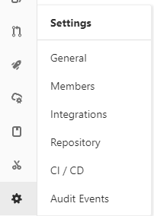

Slide 9
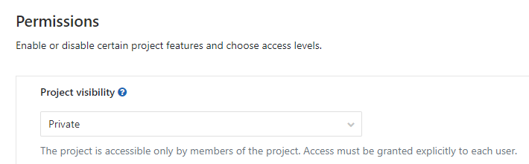

Slide 10
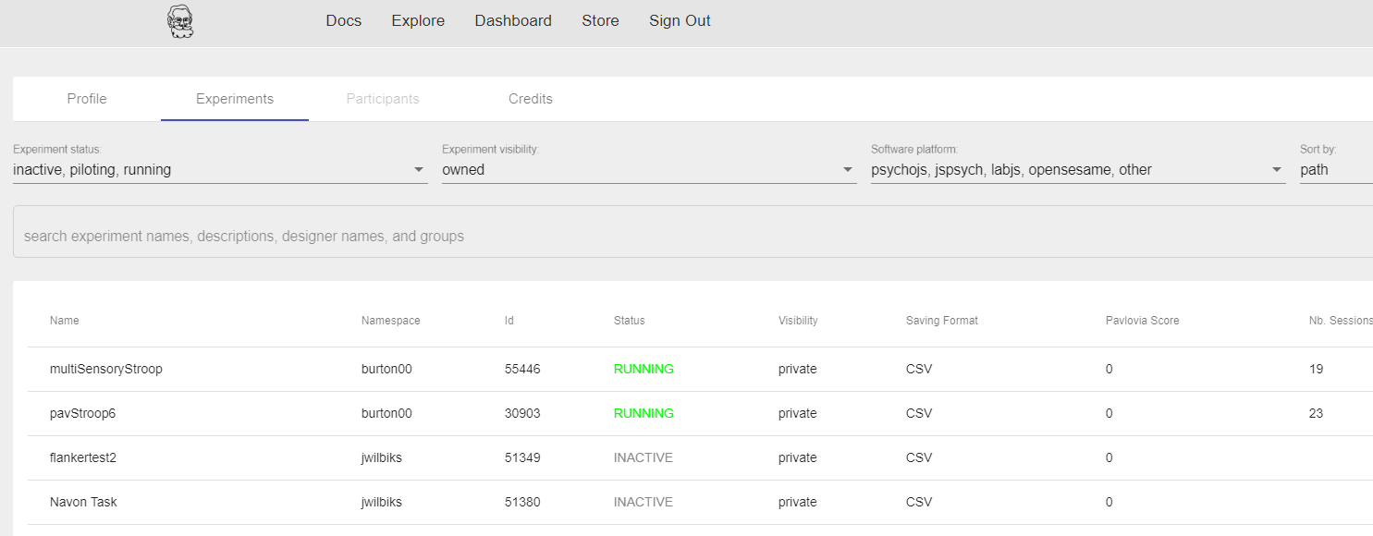

Slide 11
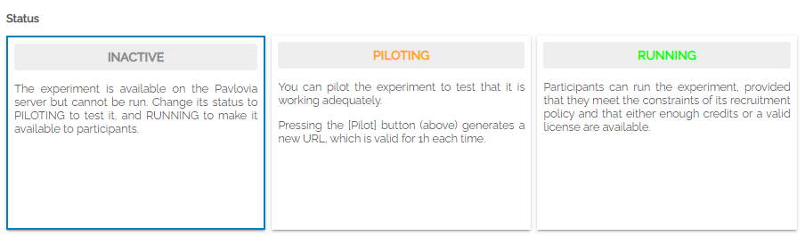
Useful for sharing your task (if public) whilst not allowing users to add data to your own repository.
Generates a pilot token
Lasts 1 hour
No credits used
No data saved to repository
Local data file downloaded
Generates sharable URL
Credit/license needed
Data saved to repository

Slide 12
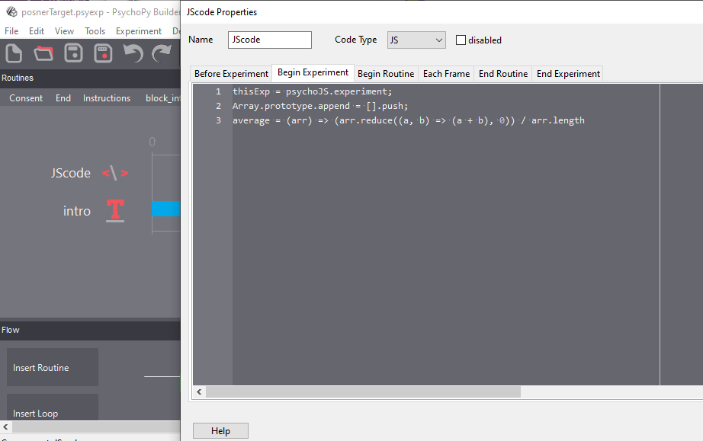

Slide 13
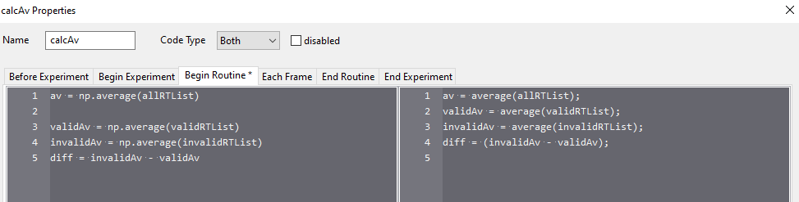

Slide 14
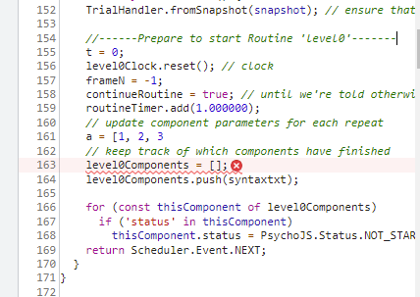
Trying to locate where an error might be happening online?
Open developer tools, click on the error and look for the name of the Routine the error occurs in.

Slide 15

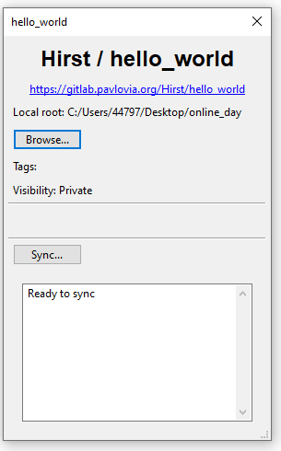
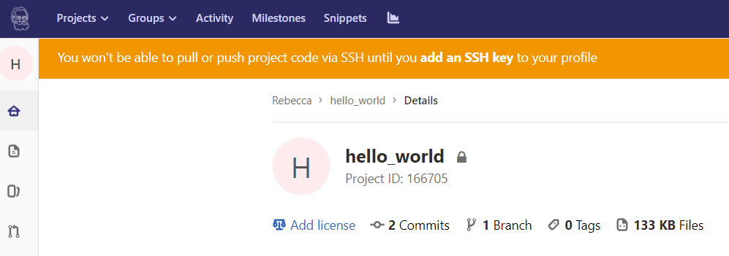
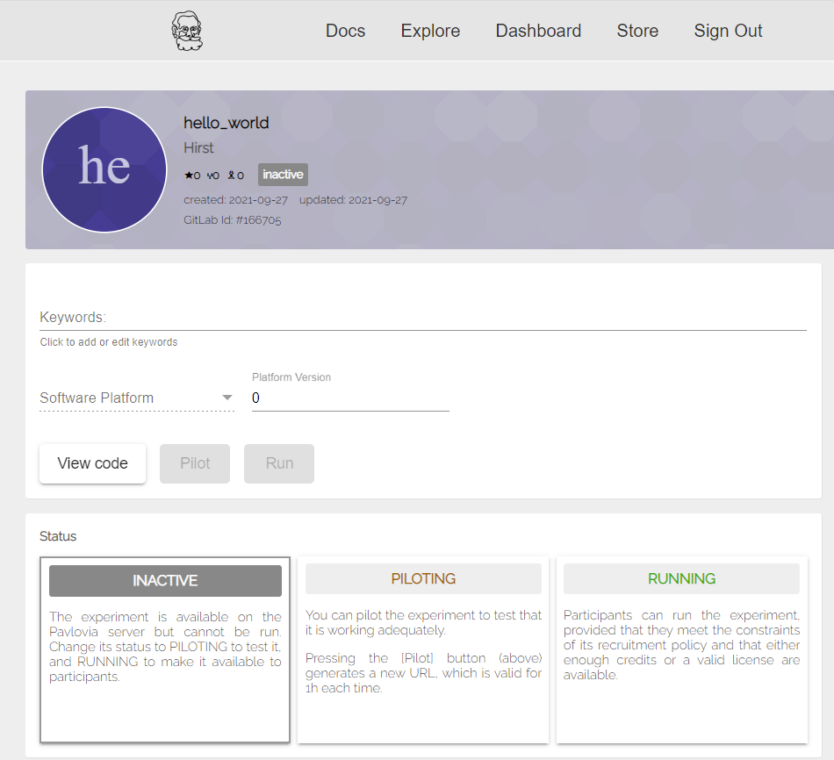

Side tip: to quickly navigate between different aspects of your project…
Check the underlying files
https://gitlab.pavlovia.org/Username/Task
Set the project status and data storage settings
https://pavlovia.org/Username/Task
Run the study:
https://run.pavlovia.org/Username/Task

Slide 16
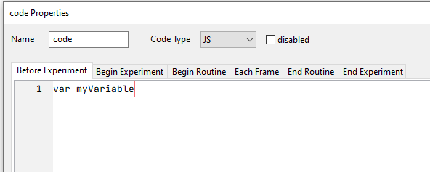
If Code Type is “JS” Builder might not automatically define your variable for you (because it is expecting you to write JS). This would create a semantic error.

Slide 17
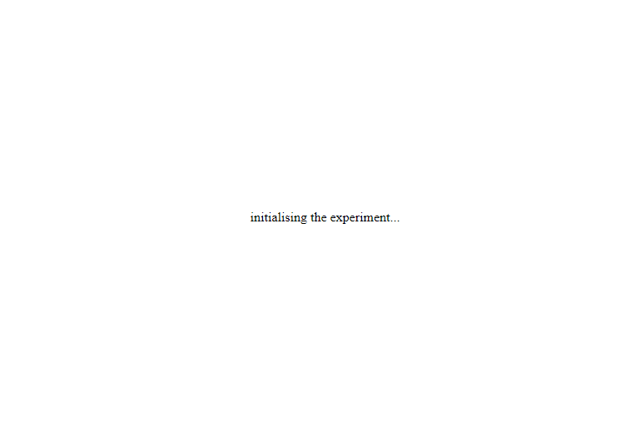

Slide 18
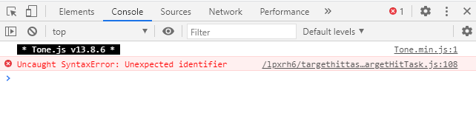

Slide 19

https://run.pavlovia.org/Username/Task/?fieldName1=value1&FieldName2=value2
and so on…
Fields are then autocompleted

Slide 20
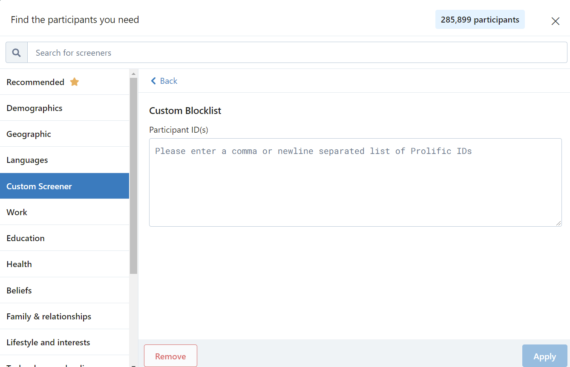
You could enter participants who completed this study in a different group…

Slide 21
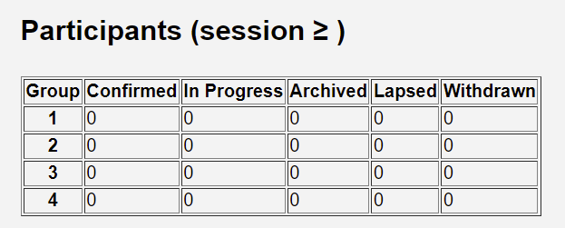

Slide 22


Slide 23

PsychoPy
Local set up
Experiment creation
PsychoJS
PsychoPy
Writes us a JavaScript version
(we can write from pure JS if you want)

Slide 24
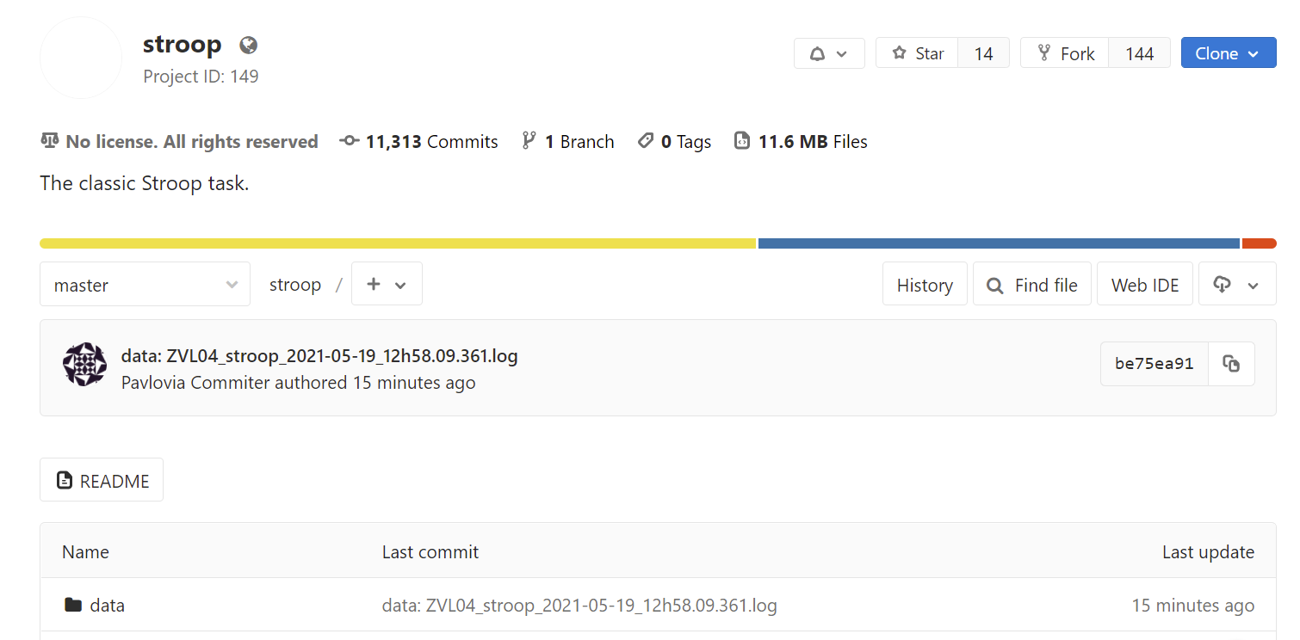

Slide 25
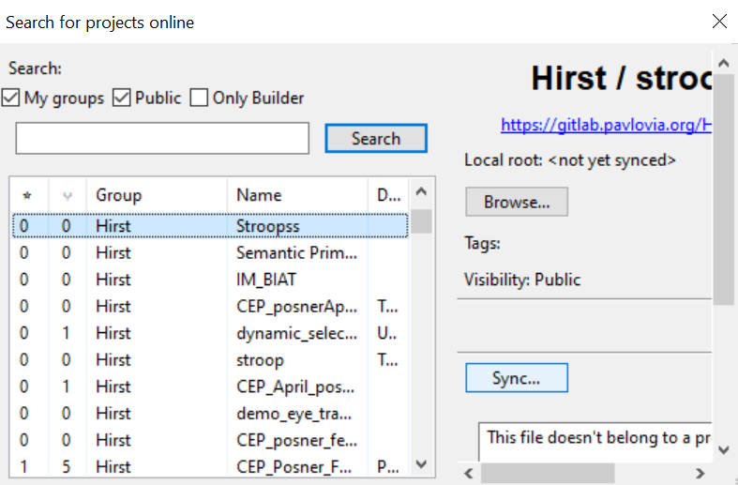

Slide 26
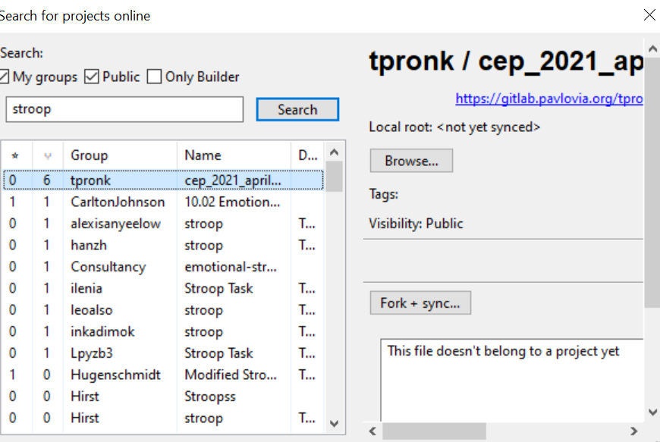

Slide 27




Github
>150 code contributors (notably, Jeremy Gray, David Bridges, Richard Höchenberger, Hiroyuki Sogo, ...)
Funders
Nottingham University pay Jon's salary while he works on this.
The Wellcome Trust and the Chan Zuckerberg Initiative have paid staff
Forum
Community helping community
(notably, Michael MacAskill, Wakefield Morys-Carter, Jonathan Kominski, Jens Boelte)
Staff (Open Science Tools ltd.)
Thanks to Pavlovia and grants we can now have paid staff to work on the project and supporting users!

Slide 28








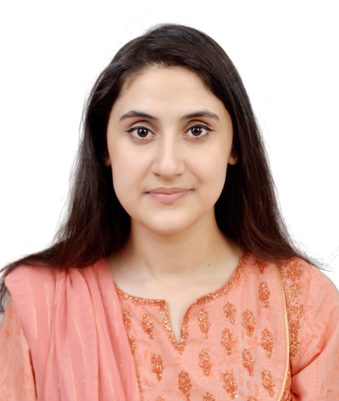



Slide 29
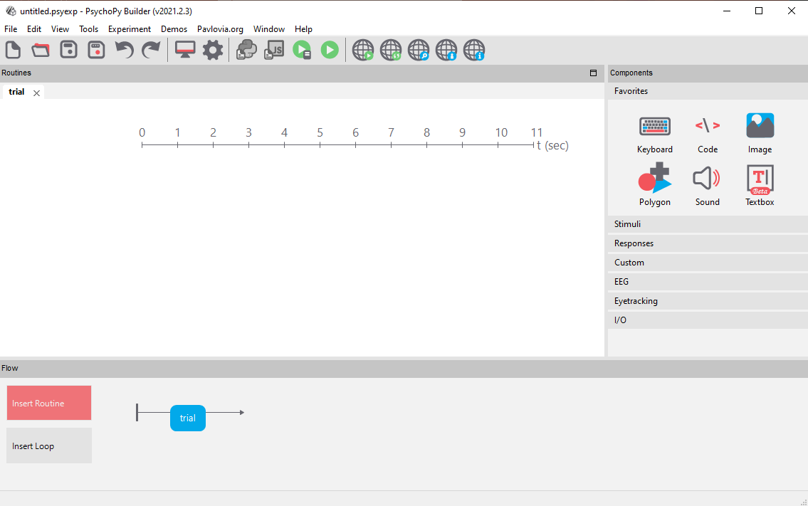
Routine
What happens in a single routine e.g. show some text, wait for a key press. Several routines can be added to the Flow.
Components
The things we can add to a routine e.g. text, pictures, key or mouse responses
Flow
The order in which things occur and if they repeat in a Loop

Slide 30
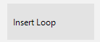
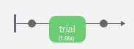
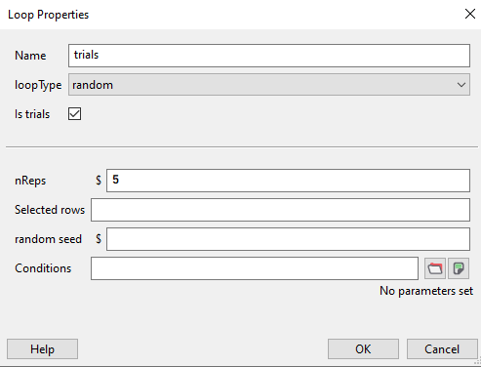
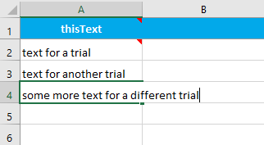
Insert loop
Click either side of the routine or routines you want to repeat
Variable name
Value of variable on each trial.
Set the loop parameters: start by making a list of info for each trial (the “conditions” file)

Slide 31
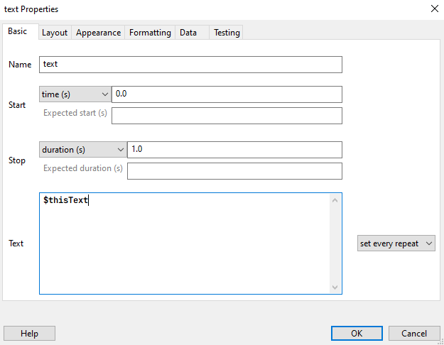
Variable name
How often it will update

Slide 32
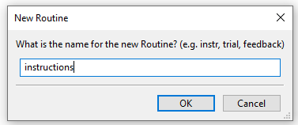
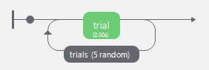
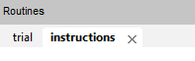
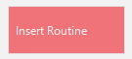
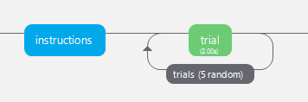
Switch between Routines by clicking on the colored boxes or using the tabs
Insert Routine
Add Routine to flow
Name the Routine
Blue Routines: No set duration e.g. ends upon a keypress
Green Routines: Set duration, e.g. all stimuli and after 2 seconds

Slide 33

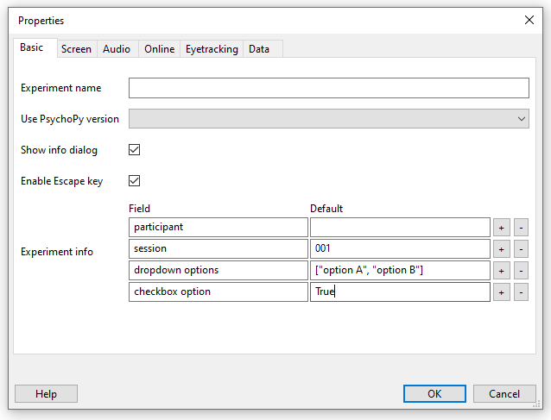
Update the info gathered at the start of the experiment and set default values

Slide 34
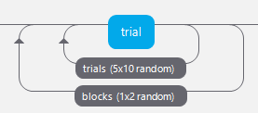
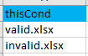
Case 1: “I have 2 blocks, where the stimuli are the same – they just ‘behave’ differently” e.g. both show text stimuli, but in different positions/size.
Set the conditions file of of the inner loop using a variable from the outer loop

Slide 35
Case 1: “I have 2 blocks, where the stimuli are the same – they just ‘behave’ differently” e.g. both show text stimuli, but in different positions/size.
Set the conditions file of of the inner loop using a variable from the outer loop

Slide 36
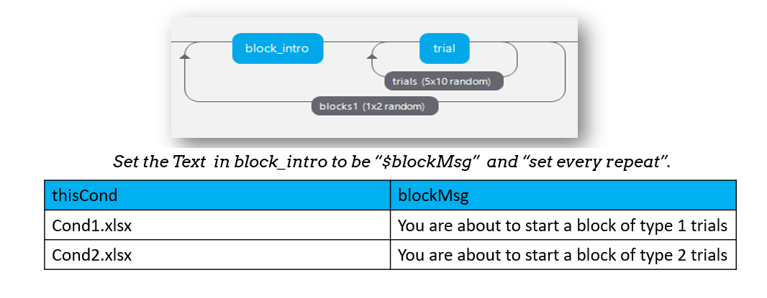
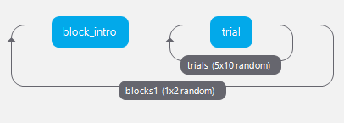
Set the Text in block_intro to be “$blockMsg” and “set every repeat”.
thisCond | blockMsg
Cond1.xlsx | You are about to start a block of type 1 trials
Cond2.xlsx | You are about to start a block of type 2 trials

Slide 37
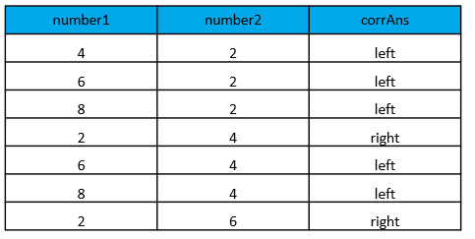
number1 | number2 | corrAns
4 | 2 | left
6 | 2 | left
8 | 2 | left
2 | 4 | right
6 | 4 | left
8 | 4 | left
2 | 6 | right

Slide 38
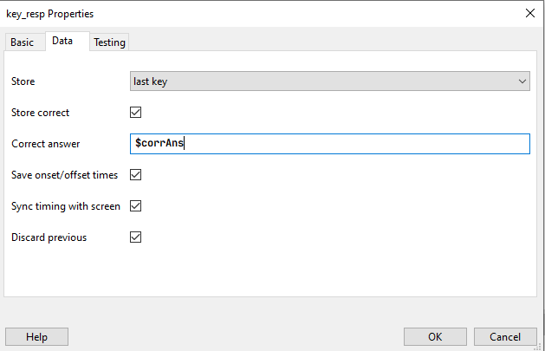

Slide 39
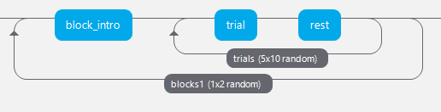

Slide 40
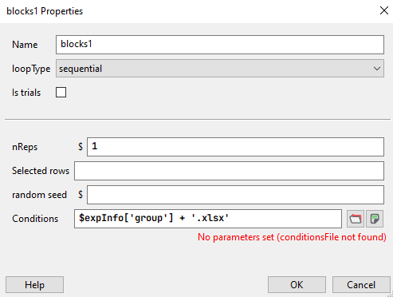
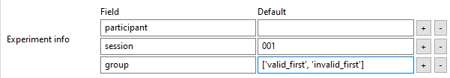
Set loopType to sequential.
Present a dropdown at the start to pick order.
Use the selected option to pick the correct spreadsheet.

Slide 41
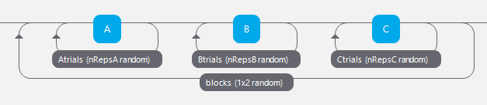

Slide 42
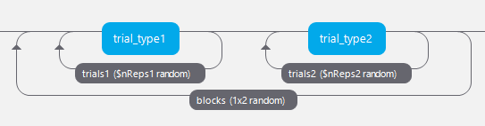
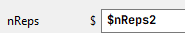
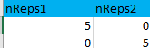
Case 2: “I have 2 blocks, where the stimuli are totally different (e.g. an audio block and a visual block)
Set the nReps of the inner loops using a variable from the outer loop

Slide 43

Compile to python (PsychoPy)
Compile to JavaScript (PsychoJS)

Slide 44
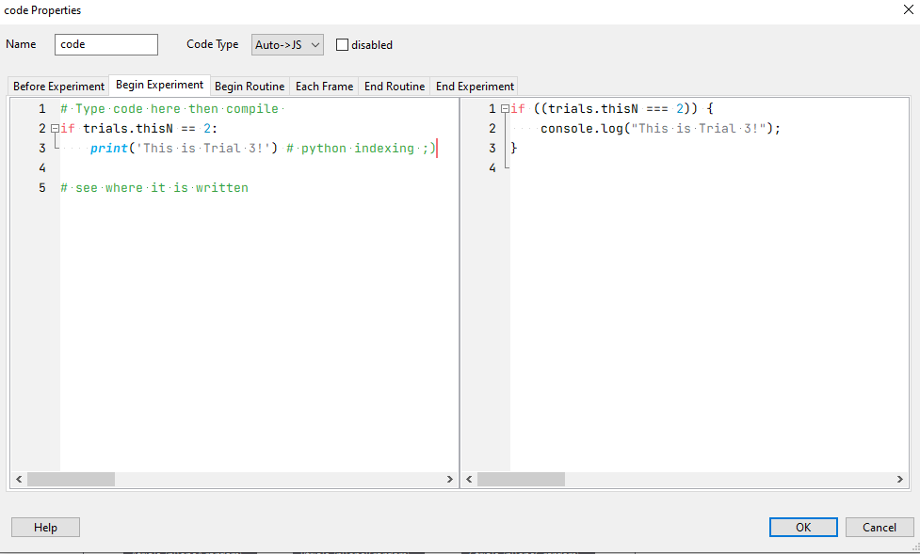
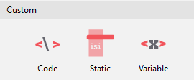
Write code in:
Auto -> JS: For online and local use
Py: for local only use
JS: for online only use
Both: For both where code cannot be “transpiled”
Python (PsychoPy)
JavaScript (PsychoJS)

Slide 45

Begin Routine
Each Frame
End Routine
Before Experiment
End Experiment
Begin Experiment
trial
e.g. when imports occur
When the experiment is initialized (equivalent to Before experiment in python)
Things to execute the end of a trial e.g. calculating an individual score
Things to execute the end of the exp e.g. calculating a final a score
For values that update every trial
For values that update every screen refresh e.g. moving things

Slide 46
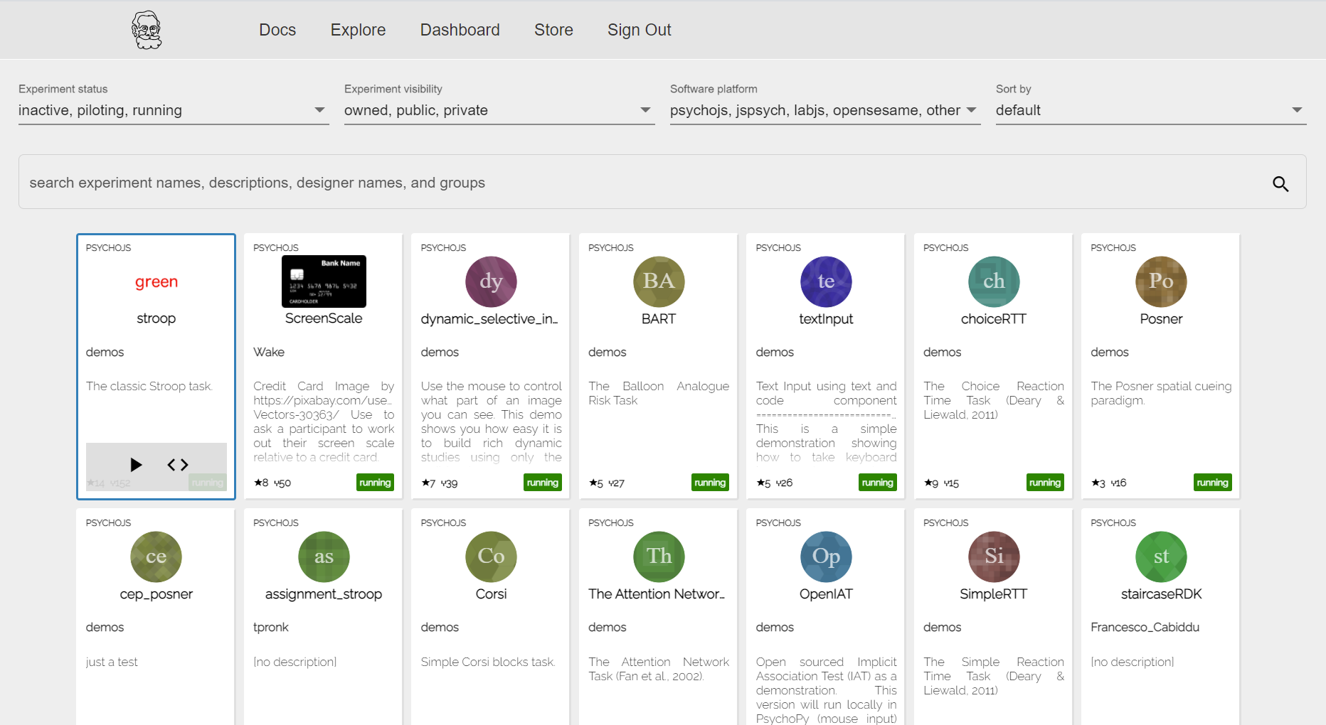
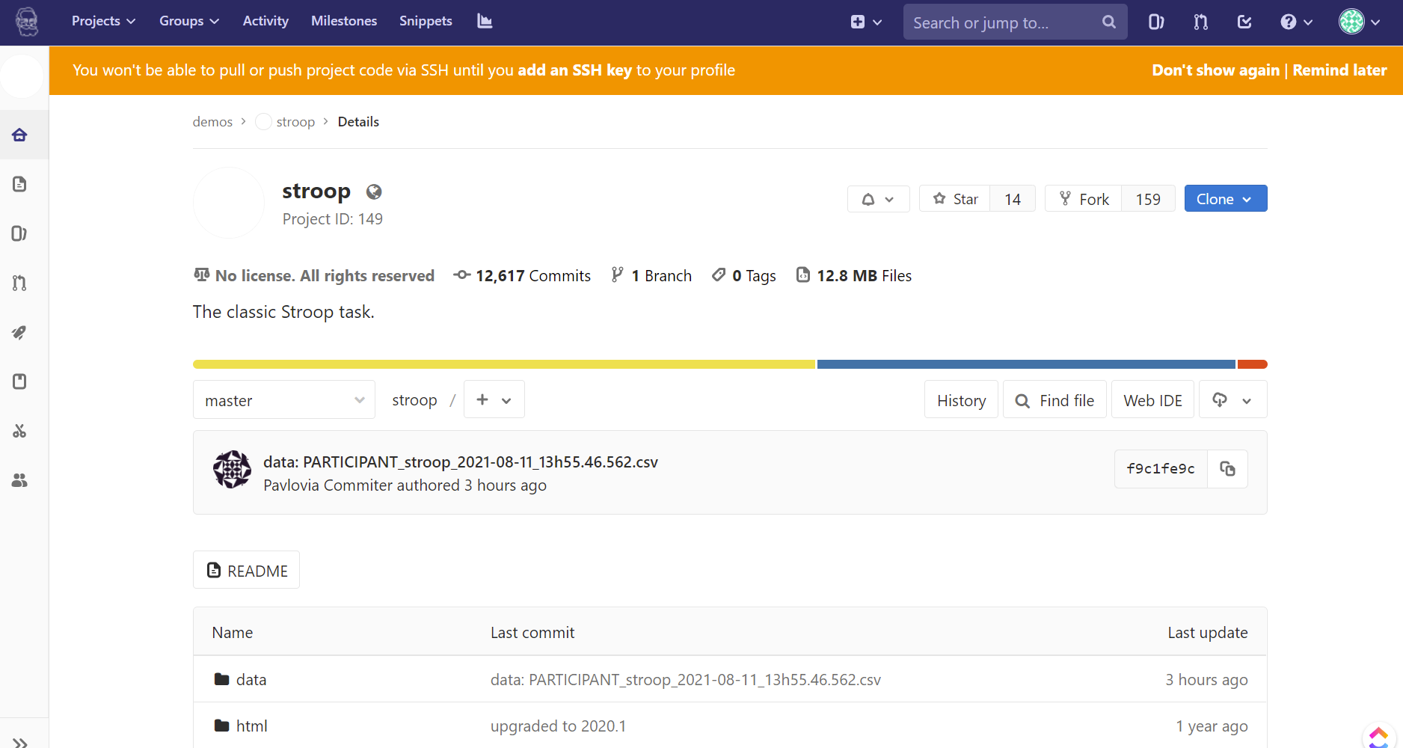
1
2

Slide 47
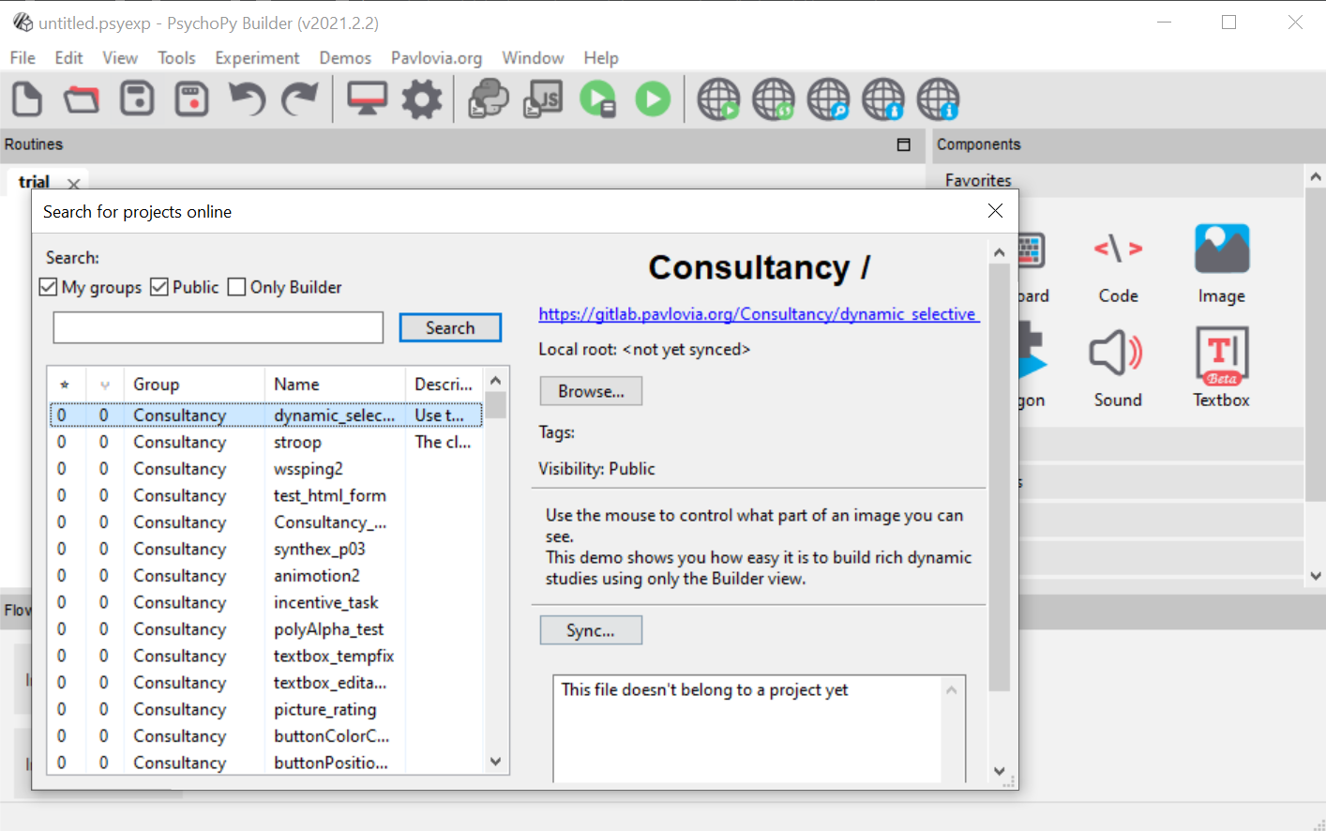
1
2
3

Slide 48
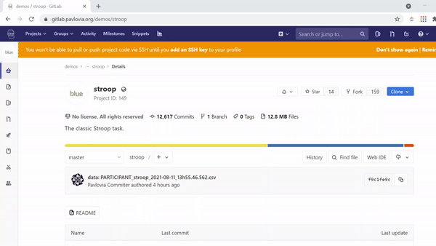

Slide 49



Slide 50

1
2
3

Slide 51

4
2
Pilot and run your study
Share your URL with participants
3
Set your data to save how you need
1
Change the status of your experiment
5
Download your data!

Slide 52

1
2
Do you want your compiled javascript to be send to a different folder? [recommend leaving blank]
3
When do you want the javascript file to be written? (and re-written)
4
Where to send the participant after the study. (e.g. daisychain with Qualtrics)
5
Resources needed by the experiment (e.g. image files, csv files).

